Slide 1

Customer Retention Analysis
Using data analysis to address customer churn

Slide 2
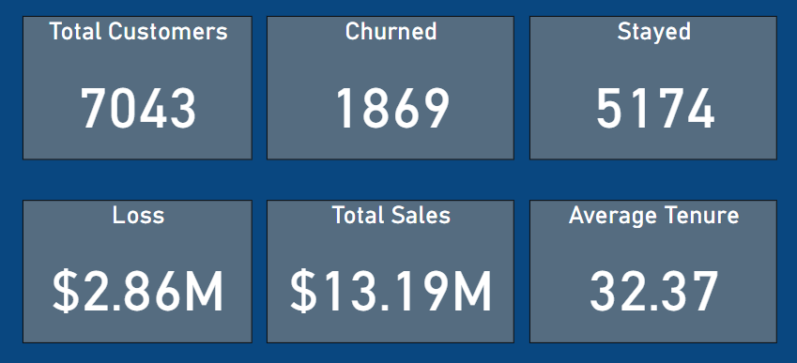
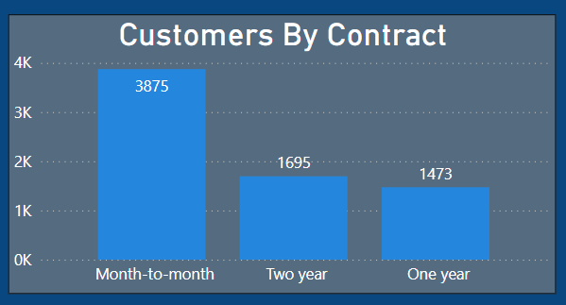
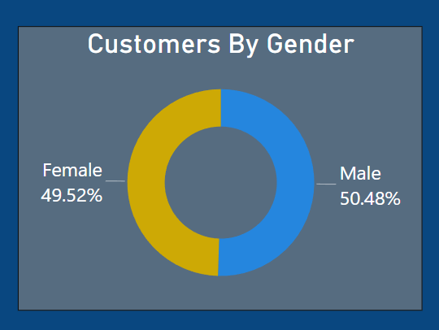
Customer Report
Gender distribution is even. A large segment of our customers prefer Month-to-Month contract . Out of 7043 customers 55.01% opted M-to-M , 24.06% opted two years and 20.93% are one year.
A total of 26.53% of our customer base churned, resulting in a substantial loss of $2.86 million.

Slide 3
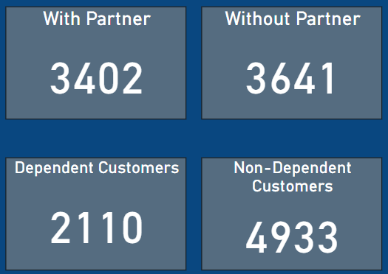
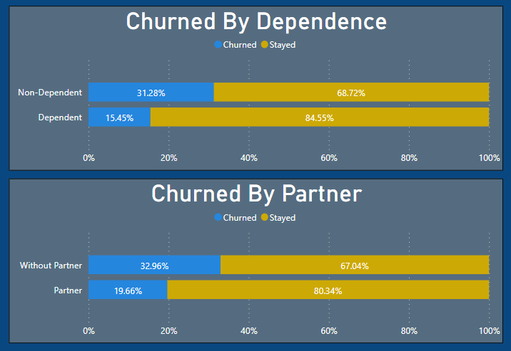
Customer Report
Marital status and dependence of our customers doesn’t have much impact on them staying or churning.

Slide 4
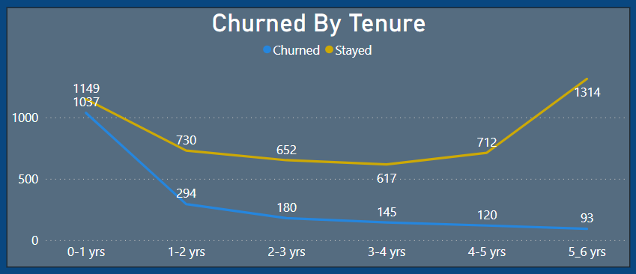
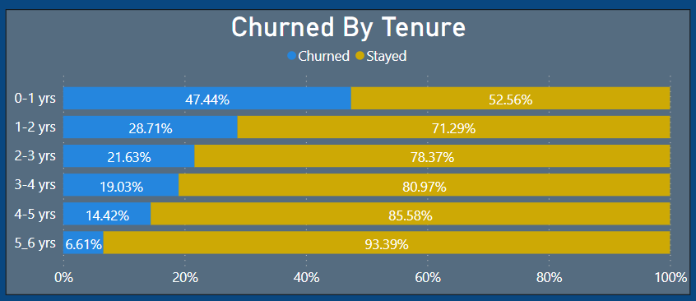
Churn Based On Tenure
The tenure significantly influences the churn rate; the longer a customer remains with us, the more likely they are to stay. Churn rates decrease as tenure increases. Specifically, 47.44% of customers with 0-1 years of tenure churned, while only 6.61% of those with 5-6 years of tenure did so.
To retain younger tenure customers, we can offer discounts, coupons, or special features when they choose longer subscription plans. This will help us keep them for a longer tenure.

Slide 5
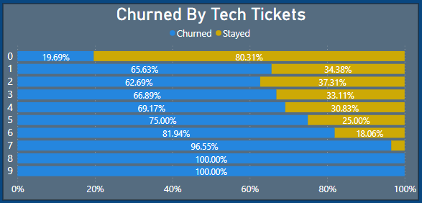
Churn Based On Tech Tickets
Our customers are experiencing numerous technical issues with our services. Notably, those who have raised a high number of tickets are the primary contributors to our churn percentage. For customers with no tickets, the churn percentage is 19.69%, while for those with 9 tickets, it reaches 100%.
To retain our customers successfully, it's imperative that we promptly address and resolve technical issues to prevent future churn and also for ensuring customer satisfaction and addressing their issues effectively, we should offer 24/7 customer support.

Slide 6
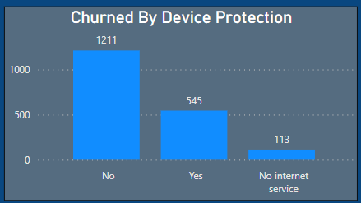
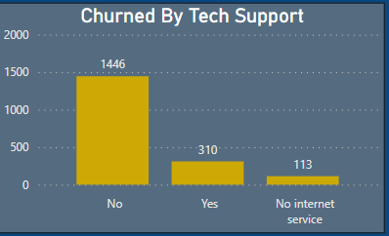
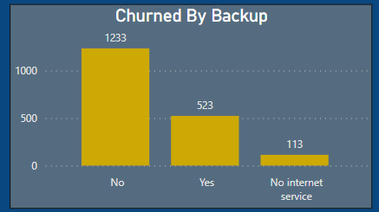
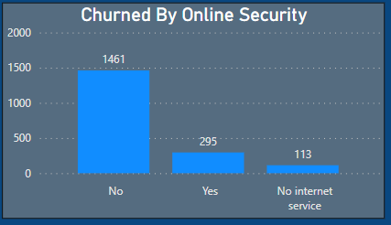
Churn Rate Based On Subscriptions
A significant portion of the customer base that has churned had not subscribed to our offered services. Device Protection(64.79%),Tech Support(77.36%),Backup Service(65.97%) and Online Security(78.17%).
To retain customers and keep them engaged with our services, we should offer special promotions, discounts, and enhance our tech support capabilities.

Slide 7
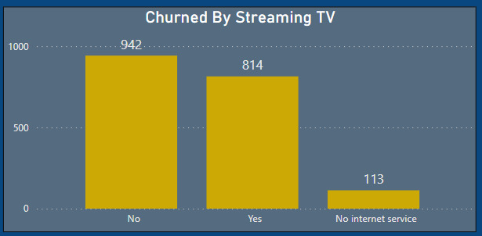
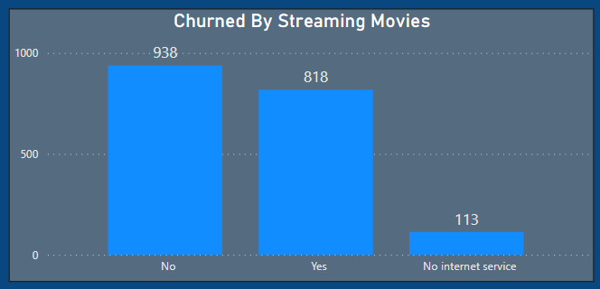
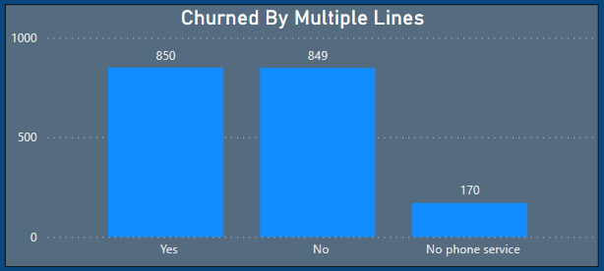
Churn Rate Based On Subscriptions
Streaming Tv , Streaming Movies and Multiple Lines doesn’t have much impact on the churn rate.

Slide 8
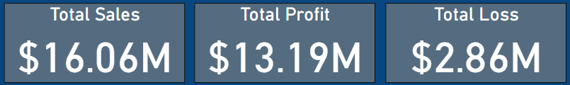
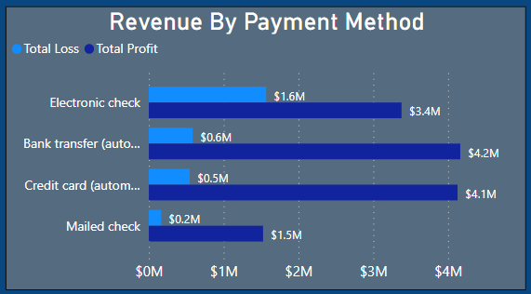
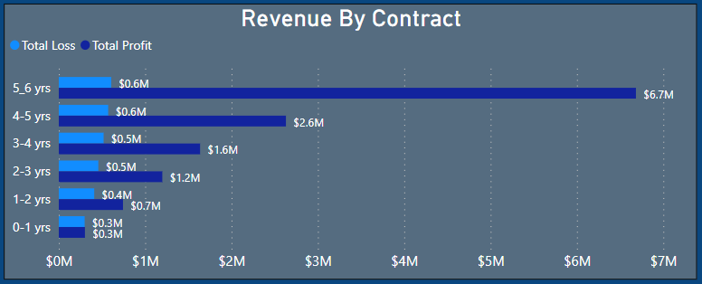
Revenue (Profit And Loss)
Our total revenue stands at $16.06 million, with a corresponding loss of $2.86 million, which represents 17.8% of our revenue. Interestingly, customers with a tenure of 5-6 years account for a significant portion of our profits, contributing 50.79% , but they are also the primary contributors to our losses. This group of customers appears to be experiencing a higher number of technical issues. To address this, it is crucial that we prioritize resolving these technical issues promptly and provide exceptional customer support .
Electronic checks are responsible for a significant 55.94% of our losses. It is imperative that we address and rectify the technical issues customers encounter while using our payment systems to mitigate these losses.

Slide 9
End Of The Report

